Slide 1
Error - exception handling
Object Oriented Programming with Java
Chapter 5
FPTU Da Nang – IT Department

Slide 2
Objectives - Content
Error & Exception Concepts
Try – catch – finally structure
throw & throws clause
Exception class definition
Exceptions and overriding

Slide 3
Error handling in Java
The usual way of handling errors of programming language is that when an error is detected, it will report an error to the user or return an abnormal value.
Java was the first programming language that handling error focus on distributed application on network environments.
Exception - errors are propagated to the source of the error by tracing and throw - returning the error to the original place.

Slide 4
Error – Exception concept
Error classification
  Error are unusual, unpredictable, unrecoverable code incident:
    out of memory, system error, network environment
  Exception: possible situations that affect the normal logic of the program
    logic error, programming error
Error & Exception types are all represented by Error & Exception classes that inherit from java.lang.Throwable class
Exception contains information about the situation, including the error type, the state of the program when the error occurs.
The JVM system is responsible for finding the program code for exception handling

Slide 5
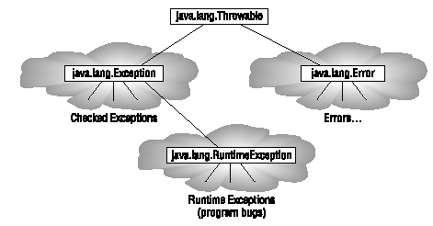
Error – Exception hierarchy
  Throwable: throw away

Slide 6
Exception
Exception classification
  Runtime exceptions:
    Errors occur at runtime, often due to poor code writing
    + Access array out of bound
    Predictable avoidance when writing source code
    RuntimeException & its subclasses
    no processing code is required
  Checked exceptions
    error has been checked, forecast
    Exception and subclasses - except RuntimeException
    must have handling code

Slide 7
Handling Exceptions
The Java compiler requires all checked Exceptions to be handled
Two Exception handling options:
  catch errors and handle using blocks try - catch - finally.
  throws error using throw and declare throws
When an error occurs, the JVM will raise an exception, the thread executing the method will terminate the execution of the next instructions after the error situation, and this exception will be thrown towards the object calling the method.
  if there is no handling code, control will return back to main() function.

Slide 8
Two error handling mechanisms
Catch error
  Use the try.. catch.. finally . construct
  Handle errors so that the program does not terminate abnormally.
  Allow re-try when there is an error/exception
Throw back an error to the original place
  Declare the method as throws Exception .
  Throw an error using the throw new Exception()
  Only throws an error when it's out of control

Slide 9
Business Exception
In Java, creating an Exception object on error and passing it to the JVM at run time is called throwing an exception.
Errors related to application logic should be represented by defining subclasses of Exception or RuntimeException
  Helps distinguish business errors and system errors
  public class BankingException extends Exception {
  public BankingException(String msg) {super(msg); }
  }

Slide 10
throw and throws
Exceptions are actually thrown from method when it is necessary to notify the calling object of error situation
Use the throw clause to throw an Exception
  if (balance<amount) throw new BankingException(“Out of money”);
The method containing the throw statement must declare the possibility of an error with the throws clause
  No need to declare throws exception if the exception is a subclass of RuntimeException
  public double withdraw(double amount) throws BankingException{
  if (balance<amount) throw new BankingException(“No money”);
  else balance-=amount;
  return balance;
  }

Slide 11
Use try.. catch.. finally
try{ doSomething; }
catch(Exception e){ doXulyLoi; }
finally { alwayDoThis; }
Try block:
  statements that can generate an exception.
  will terminate the execution of the remaining instructions to jump to the catch block when an error occurs.
Catch block:
  error that handling error.
  Error information stored in Exception e
  If there are more than one type of Exception then multiple catch blocks can be used.
  Cannot catch if there is no possibility of error in the try . block
Finally block: (optional)
  statements will be executed, regardless of errors or not

Slide 12
Use try.. catch..
Example:
  int x = (int)(Math.random() * 5);
  int y = (int)(Math.random() * 10);
  int [] z = new int[5];
  try {
  System.out.println(“y/x gives “ + (y/x));
  System.out.println(“y is “+ y + “ z[y] is” + z[y]);
  }
  catch (ArithmeticException e) {
  System.out.println(“Arithmetic problem” + e);
  }
  catch (ArrayIndexOutOfBoundsException e) {
  System.out.println(“Subscript problem” + e);
  }
Try must be accompanied by catch or finally

Slide 13
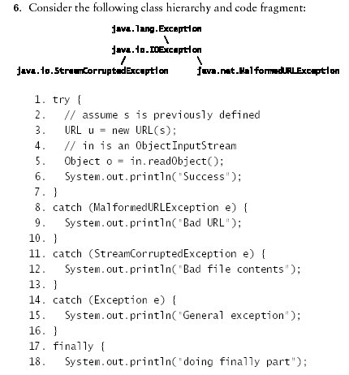

Slide 14
Exceptions and Overriding
The override method is not allowed to throw more checked exceptions than the overriden method in the base class
  For that reason, some base classes need to declare throws an Exception even though there isn't an Exception
The override method can throw Exceptions so that these exceptions are subclasses of the exception thrown in the overriden method.

Slide 15
Exception & Overriding
Review question
The risky() method might throw a java.io.IOException, java.lang.RuntimeException, java.net.MalformedURLException (which is a subclass of java.io.IOException). Which of the following classes and sets of classes are legal?
A. public class SomeClass {
public void aMethod() {
risky();
}
}
B. public class SomeClass {
public void aMethod() throws IOException {
risky();
}
}

Slide 16
Exception & Overriding
C. public class SomeClass {
public void aMethod() throws RuntimeException {
risky();
} }
D. public class SomeClass {
public void aMethod() {
try {
risky();
}
catch (IOException e) {
e.printStackTrace();
}
}
}

Slide 17
Exception & Overriding
E. public class SomeClass {
public void aMethod() throws MalformedURLException {
try {
risky();
}
catch (IOException e) { }
}
};
public class AnotherClass extends SomeClass {
public void aMethod() throws java.io.IOException {
super.aMethod();
}
}

Slide 18
Constructive questions
How is error handling in Java different from other languages?
When errors should be catched, should be thrown?
How to prevent the program from crashing because the user accidentally entered the wrong data?
Write a function that allows input of an integer from the keyboard, valid from m to n. Any invalid input is allowed to re-enter until ok
A function declaration throws Exception, even though the function body is not capable of generating an error. What is this for?
Define a class of business exception of the library management application. System logging when errors occur.

